Slide 1
Computer & Desk Stretches Approximately 4 Minutes
Sitting at a computer for long periods often causes neck and shoulder stiffness and occasionally lower back pain.
Do these stretches every hour or throughout the day, or whenever you feel stiff.
Photocopy this and keep it in a drawer.
Also, be sure to get up and walk around the office whenever you think of it. You’ll feel better!
林順松 0933-837-737 www.unoldlin.com

Slide 2
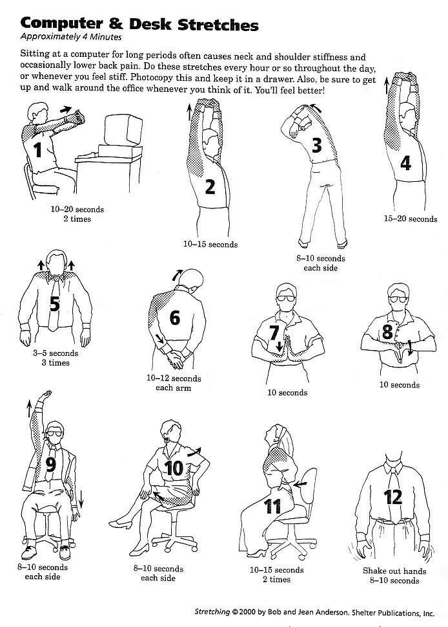
Overview

Slide 3
3

Slide 4
2

Slide 5
1

Slide 6
Action!

Slide 7
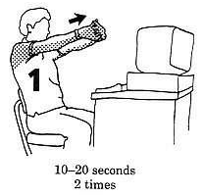
1-1

Slide 8
1
Once more!

Slide 9
1-2

Slide 10
Stand up!
林順松 0933-837-737 www.unoldlin.com

Slide 11
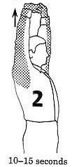
2

Slide 12
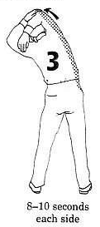
3-left side

Slide 13
3
Turn the other side!

Slide 14
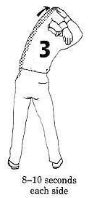
3-right side

Slide 15
4

Slide 16
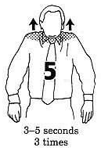
5-1

Slide 17
5-2

Slide 18
5-3

Slide 19
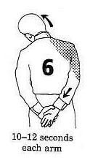
6-right arm & hand

Slide 20
6
Turn the other side!
林順松 0933-837-737 www.unoldlin.com

Slide 21
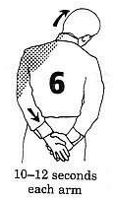
6-left arm & hand

Slide 22
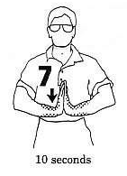
7

Slide 23
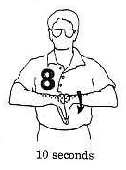
8

Slide 24
Sit down and raise the left hand!

Slide 25
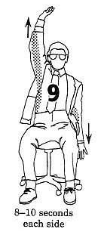
9-right up & left down

Slide 26
9
Turn the other side!

Slide 27
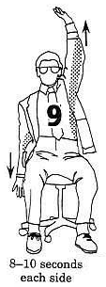
9-right down & left up

Slide 28
9
Raise and cross the left leg!
林順松 0933-837-737 www.unoldlin.com

Slide 29
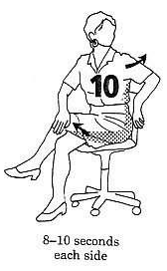
10-left arm & leg

Slide 30
10
Turn the other side!

Slide 31
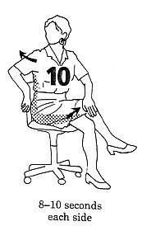
10-right arm & leg

Slide 32
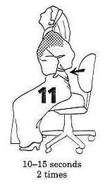
11-1

Slide 33
11
Once more!

Slide 34
11-2

Slide 35
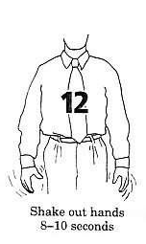
12

Slide 36
The End.
Continue Again?!
Or
Press “ESC” to Stop.
林順松 0933-837-737 www.unoldlin.com

